Slide 1
Impulse and Momentum in a Particle
Dr. Jacob Moore
Associate Professor of Engineering
Penn State Mont Alto

Slide 2
Impulse and Momentum
So far...
We have used kinematics to relate position, velocity, and acceleration.
And we have used the force mass and acceleration branch of kinetics, to relate forces to the motion of bodies.
We have used work and energy methods (a second branch of kinetics), as an alternative to the force, mass, and acceleration method.
Now we will use the impulse momentum method (a third branch of kinetics), as an alternative to both the force, mass and acceleration method and the work and energy method.

Slide 3
Impulse and Momentum
Impulse and momentum are related in that the net impulse exerted on a body over some time will be equal to the change in that body’s momentum.
$$\overset{⃑}{J}=m\overset{⃑}{v_{f}}−m\overset{⃑}{v_{i}}$$
Initial Momentum
Impulse
Final Momentum

Slide 4
Impulse
The impulse of a constant force over a set time will be equal to the magnitude of the force time the duration of the time.
$$\overset{⃑}{J}=\left(\overset{⃑}{F}\right)\left(t\right)$$
More generally, the impulse by any force (which may change over time) is equal to the integral of the force some set time period.
$$\overset{⃑}{J}=\int_{t1}^{t2}{F\left(t\right)dt}$$
In addition to a magnitude, an impulse will also have a direction. Assuming the force has a constant direction, the direction of the force will be the direction of the impulse.

Slide 5
Momentum
The momentum of a body will be the mass of the body times the velocity of that body.
$$m∗\overset{⃑}{v}$$
Unlike an impulse which occurs over time, the momentum is instantaneous.
We will be particularly interested in some initial momentum and some final momentum, with the impulse acting on the body between these two points in time
The momentum has a direction as well. The direction of the momentum will be the instantaneous direction of the velocity.

Slide 6
Impulse and Momentum in Two Dimensions
Remember that both Impulse and Momentum are vector quantities...
$$\overset{⃑}{J}=m\overset{⃑}{v_{f}}−m\overset{⃑}{v_{i}}$$
This means that for two dimensional problems we can rewrite the vector equation as two scalar equations.
$$J_{x}=mv_{fx}−mv_{ix}$$
$$J_{y}=mv_{fy}−mv_{iy}$$

Slide 7
Solving a Work and Energy Problem (The Process)
Solving impulse momentum involves three steps, carefully accounting for the factors at play between some initial state and some final state.
Set up one diagram showing the initial state and set up some other diagram for the final state.
Identify any external forces that will act on the body between the two states
Identify the known or unknown velocities in each state
Use the diagram to put together the impulse momentum equation, with included known and unknown values.
$\overset{⃑}{J}=m\overset{⃑}{v_{f}}−m\overset{⃑}{v_{i}}$
Split this equation into x and y components if appropriate
Solve the equations for the unknown quantities

Slide 8
Thanks for Watching
See other engineering mechanics videos and access the full tool at…

Slide 9
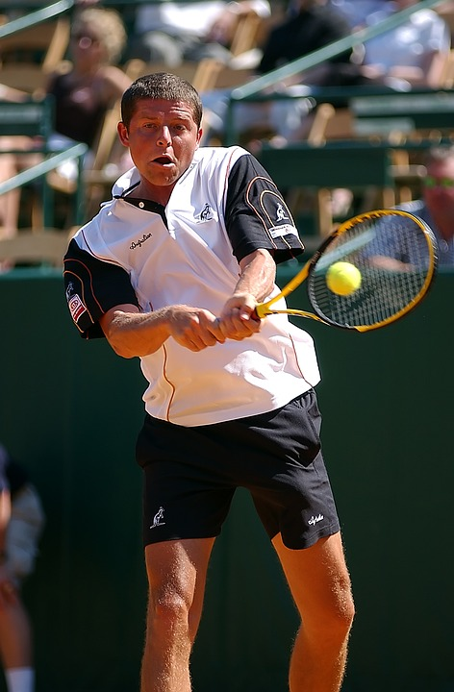
Worked Example
A tennis ball (.06 kg) is served to tennis player at a speed of 10 m/s. The player then returns the ball at a speed of 36 m/s.
What is the change in momentum for the ball?
If a high speed camera reveals the impact lasted .02 seconds, what is the average force exerted on the ball?

Slide 10
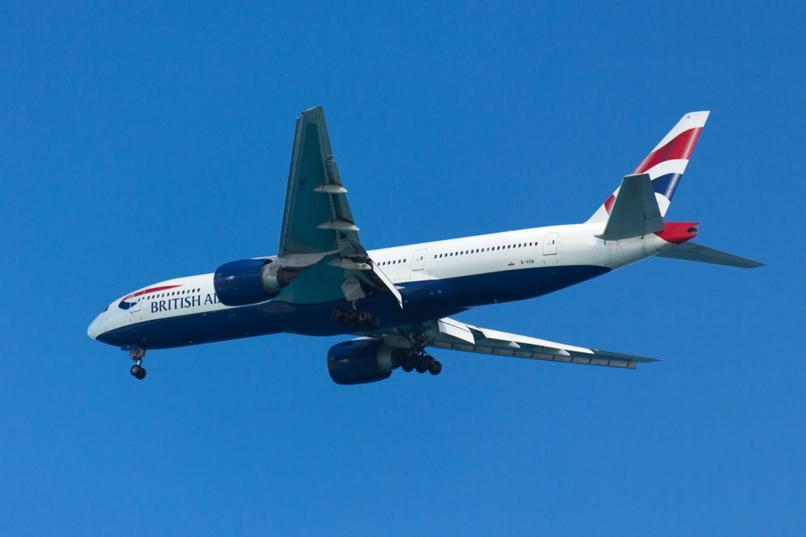
Worked Example
A plane with a mass of 80,000 kg is traveling a velocity of 200 meters per second when the engines cut out. 20 seconds later, it’s noticed that the velocity has dropped to 190 m/s. Assuming the plane is not gaining or losing altitude, what is the average drag force on the plane?

Slide 11
Worked Example
The plot below shows the thrust generated by the engine on a jet fighter (2500 kg) over ten seconds. If the plane is starting from rest on a runway and friction and drag are negligible, determine the speed of the plane at the end of these ten seconds.
12 kN
Force
(kN)
Time
(s)
4 s
10 s

Slide 12
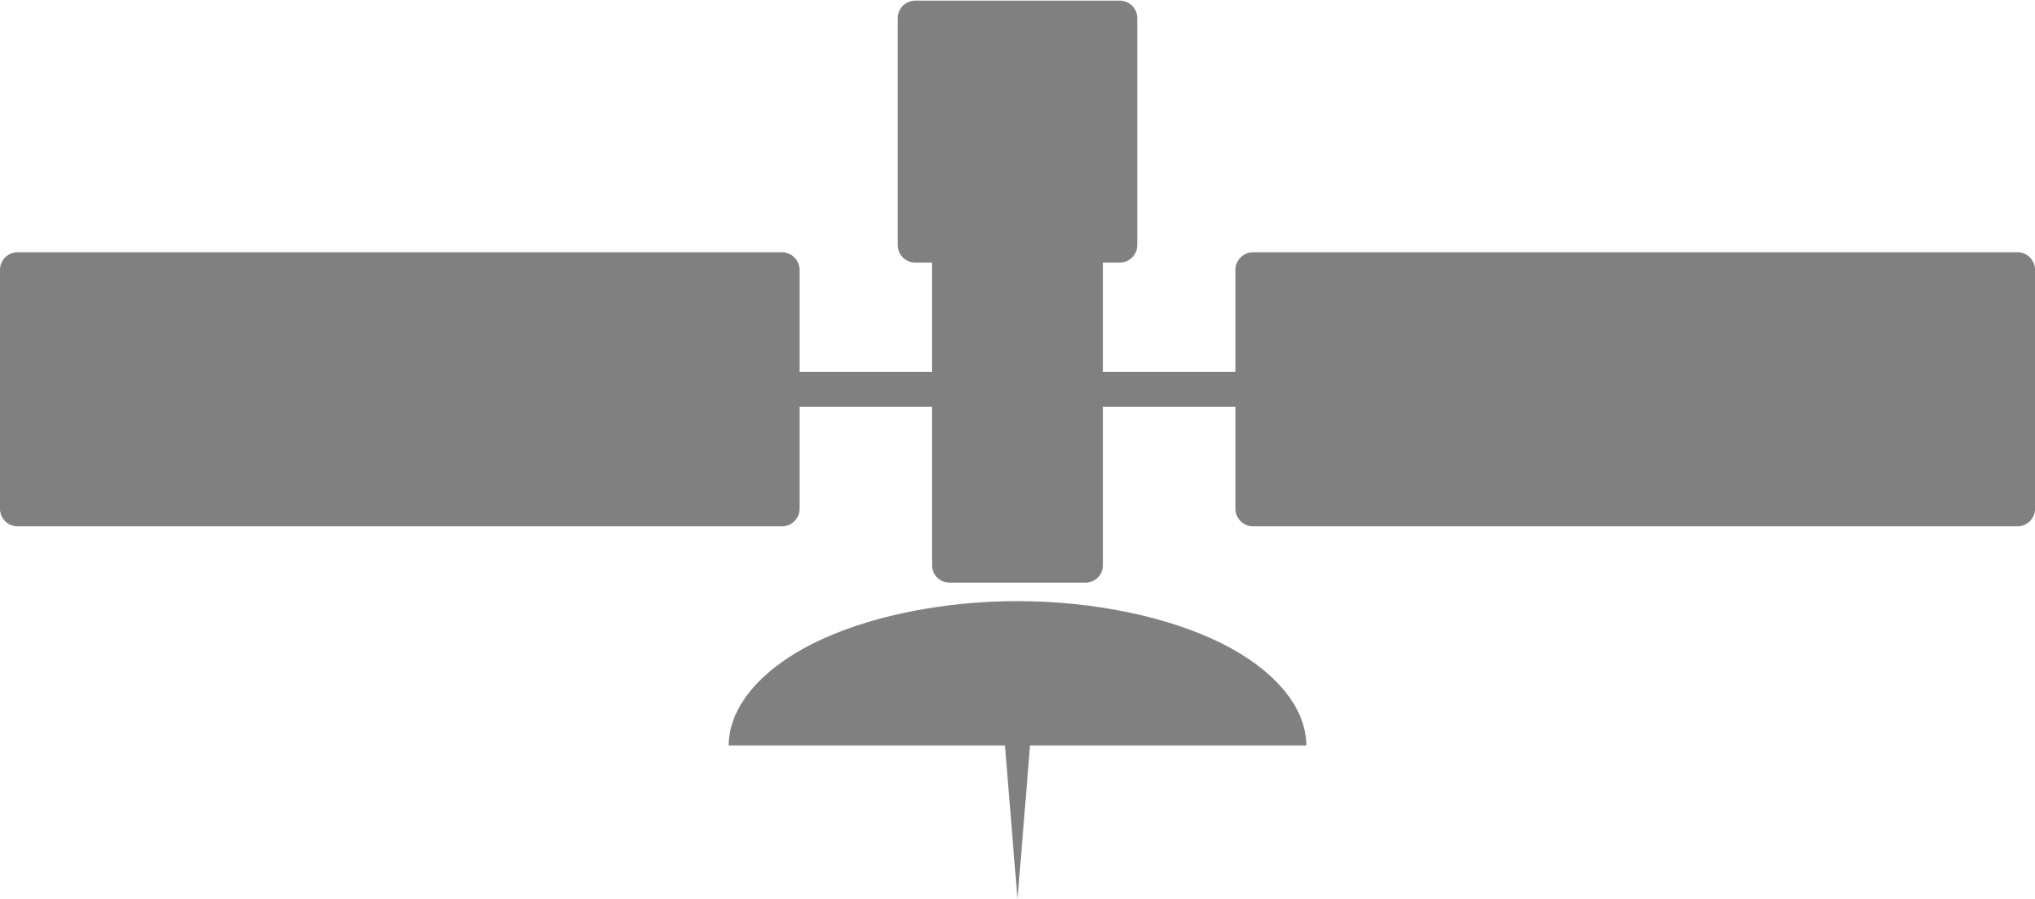
Worked Example
A satellite with a mass of 12,000 kg and a speed of 600 m/s fires a thruster exerting a force of 600 kN at a 30º angle with the current path as shown below. The thruster is turned off after completing a 90º turn as shown below.
How long is the thruster on?
What is the final velocity of the satellite?
$$F_{T}$$
30º

Slide 13
Worked Example
A satellite with a mass of 12,000 kg and a speed of 600 m/s is traveling 30º from horizontal. If the capsule is to have the same speed but travel horizontally after 10 seconds, what is the magnitude and direction of the required average thruster force?
30º

